Slide 1
E-Learning vs Mobile Learning
Muhammad Zulhazman bin Hazli A153116
Muhammad Afif bin Nor Hassim A153212
Marya Hasnah binti Ruslee A154900
GE1155 - Computer In Education

Slide 2
What is e-Learning?
E-learning is utilizing electronic technologies to access educational curriculum outside of a traditional classroom.
Another definition, it is a formalized teaching and learning system specifically designed to be carried out remotely by using electronic communication.
It is a course or program or degree that is delivered completely online.

Slide 3
What is mobile-Learning?
Mobile learning involves the use of mobile technology, either alone or in combination with other information and communication technology (ICT), to enable learning anytime and anywhere.
Question to ponder : Since students already have smartphones in hand, why not build classroom activities around them?

Slide 4
Features of E-learning
Cost effectiveness
Time saving
Rich media support
Test Engine
Accessibility
Learning is self-paced and gives students a chance to speed up or slow down as necessary
Accommodates multiple learning styles using a variety of delivery methods geared to different learners; more effective for certain learner
Fosters greater student interaction and collaboration
Fosters greater student/instructor contact
Enhances computer and Internet skills

Slide 5
Features of Mobile learning
Learning can unfold in a variety of ways: people can use mobile devices to access educational resources, connect with others, or create content, both inside and outside classrooms.
Using portable computing devices (such as iPads, laptops, tablet PCs, PDAs, and smart phones) with wireless networks enables mobility and mobile learning.
Allowing teaching and learning to extend to spaces beyond the traditional classroom.
Allowing learners to obtain learning materials anywhere and anytime using mobile technologies and the Internet.
The core characteristics of mobile learning are ubiquitous, portable size of mobile tools, blended, private, interactive, collaborative, and instant information.
They enable learners to be in the right place at the right time, that is, to be where they are able to experience the authentic joy of learning.

Slide 6
Comparison of E-learning & Mobile Learning
Both e-learning and mobile learning are able to contribute to the world of education in various ways.
Both use electronic devices.
Both allow teaching and learning be held at a new level.
Both have easy access to learning materials.
Both saves time.

Slide 7
Contrast of E-learning & Mobile Learning
E-learning enables you to enhance your computer and internet skills.
E-learning fosters greater student interaction and collaboration.
E-learning fosters greater student and instructor contact.
Mobile learning enables using computing devices that enables mobility.
Mobile learning enables you to have private education or lessons without other people viewing them.

Slide 8
When is the right time to implement?
According to a research, the right time to implement E-learning and Mobile learning is NOW. That is this current period. Because :
We are experiencing an increase of human intelligence.
We are experiencing an increase in the economy sector.
There are various electronic devices being sold in the market.
It is time to train our youths to shape and prepare them to lead our country to a better one.

Slide 9
Examples
E-Learning
Web-based learning
Virtual classrooms
Digital collaboration
Mobile-Learning
QR Codes
Smartphones : toy to tool
Mobile application for learning
Digital books

Slide 10
Why e-learning and mobile-learning?
Lower costs
Faster delivery
More effective learning
Lower environmental impact
24/7 accessibility
Enhanced collaboration and reachable

Slide 11
Who may use this technique?
Disable people
New generation
Employer

Slide 12
Where it can be implemented?
Schools
Higher education institution
Corporate sector

Slide 13
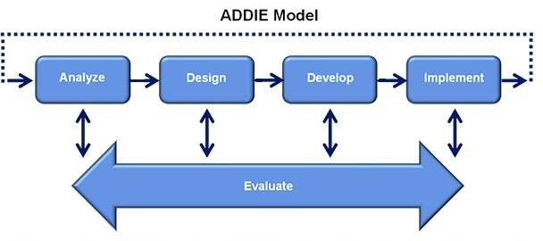

Slide 14
ADVANTAGES & DISADVANTAGES

Slide 15
ADVANTAGES
e-Learning | Mobile-Learning
Accessible | Convenience and flexibility
Self-pacing | Relevance
On-demand availability | Fits different learning styles
Interactivity & Creativity | Education similarities
Flexibility | Wider Access
Collaboration & teamwork | Interactive communication

Slide 16
DISADVANTAGES
e-Learning | Mobile-Learning
Limited access | Cost
Trial difficulties | Size of device
Learning Approach | Endurance
Computer competency | Capacity
Portability | Usability

Slide 17
HOW TO IMPLEMENT
E-LEARNING & MOBILE-LEARNING
Identify needs & audiences
Tools
Training
Social Learning
Quiz Learner

Slide 18
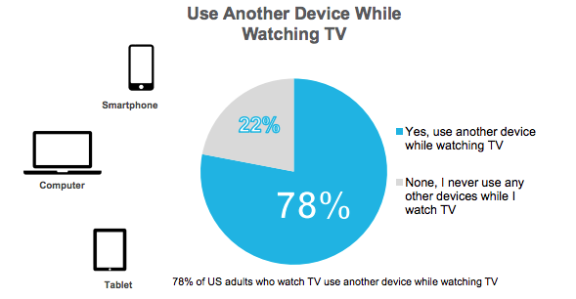
STATISTICS OF USING DEVICES IN DAILY LIFE

Slide 19
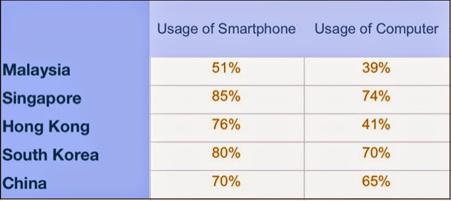
STATISTICS OF USING DEVICES IN DAILY LIFE

Slide 20
CONCLUSION
Which one is preferable????
E-Learning
Mobile-Learning
vs

Slide 21
REFERENCES
https://www.google.com/search?q=statistics+of+people+using+smartphones&espv=2&biw=1366&bih=623&source=lnms&tbm=isch&sa=X&ved=0CAcQ_AUoAmoVChMInsGkgpnFyAIVDBuOCh1YygJr#tbm=isch&q=percentage+of+smartphone+vs+computer+in+malaysia+2015&imgrc=LGt1EtL3-T1zsM%3A
https://my360mobile.files.wordpress.com/2015/01/blogger-image-1925771616.jpg?w=700
http://blog.commlabindia.com/learning-technology/steps-to-implement-mlearning
https://youtu.be/6Q5IsDvO8gs
http://www.optimussourcing.com/learninghintsandtips/the-advantages-and-disadvantages-of-elearning
http://www.webopedia.com/TERM/E/e_learning.html
http://www.kineo.com/resources/new-to-elearning/the-benefits-of-elearning
Technology enhanced learning for people with disabilities: approaches and application
http://www.edutopia.org/article/mobile-learning-resources
http://www.worldwidelearn.com/elearning-essentials/elearning-benefits.htm
http://www.elearningindustry.com/
http://www.opencolleges.edu.au/informed/features/how-educators-are-practicing-mobile-learning/
http://www.unesco.org/new/en/unesco/themes/icts/m4ed/

Slide 22
THANK YOU

